Slide 1

A MACHINE LEARNING APPROACH FOR CLASSIFYING CUISINES

Slide 2
AIM
TO PREDICT A CUISINE BASED ON ITS INGREDIENTS

Slide 3
DATA SOURCE
The data was scraped from
www.allrecipes.com
www.epicurious.com
www.menupan.com
by Yong-Yeol Ahn, Sebastian E. Ahnert, James P. Bagrow & Albert-Laszlo Barabasi
in 2011.

Slide 4
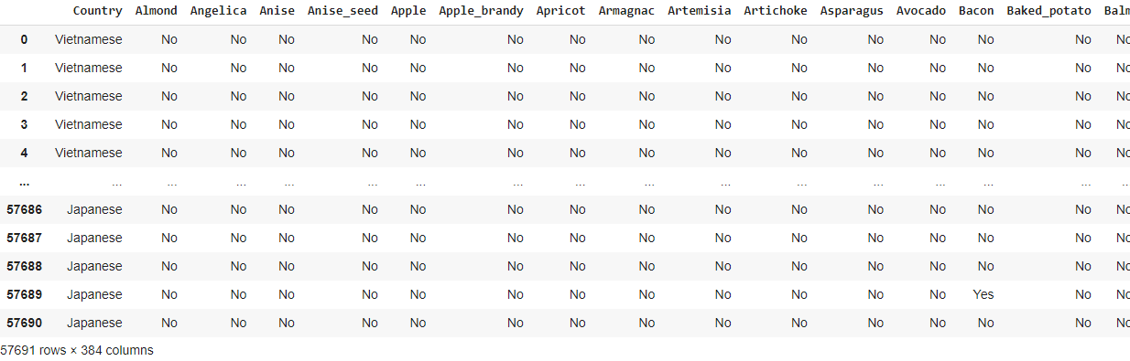
DATA LAYOUT

Slide 5
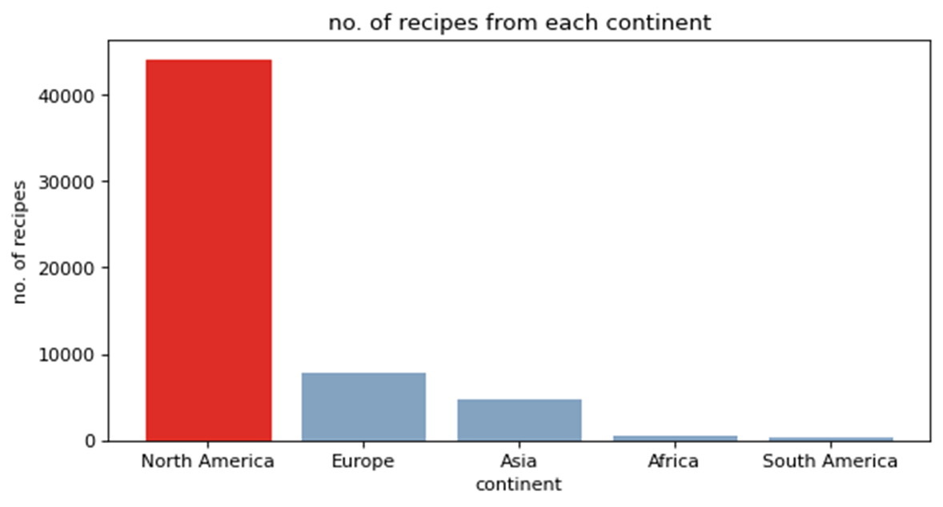
NO. OF RECIPES FROM EACH CONTINENT

Slide 6
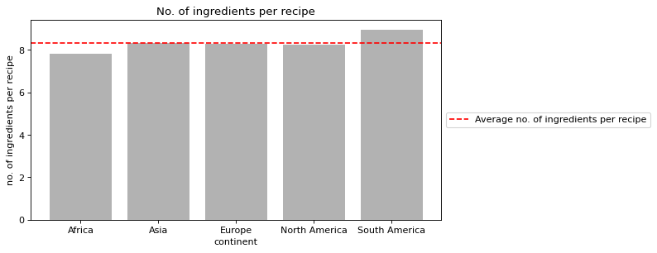
NO. OF INGREDIENTS PER RECIPE

Slide 7
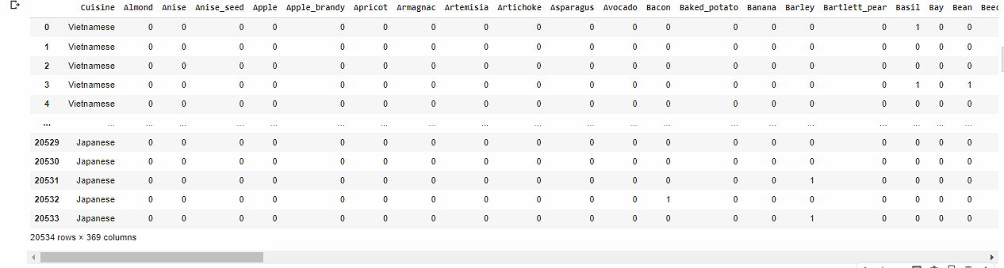
FEATURE ENGINEERING

Slide 8
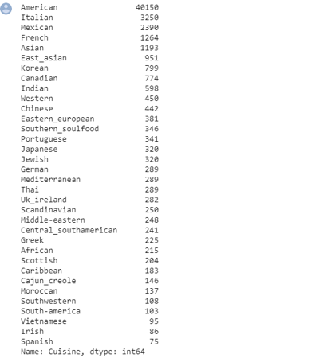
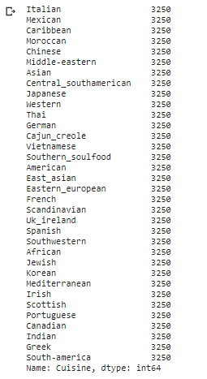
FEATURE ENGINEERING

Slide 9
ALGORITHMS EXPLORED
Decision Tree Classifier
xGBoost Classifier
Random Forest Classifier
Algorithms
Extra Tree Classifier
Multi Layer Perceptron Classifier

Slide 10
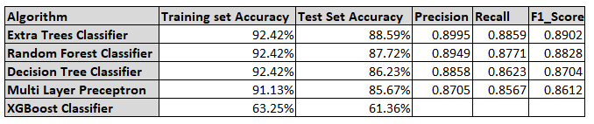
RESULT

Slide 11
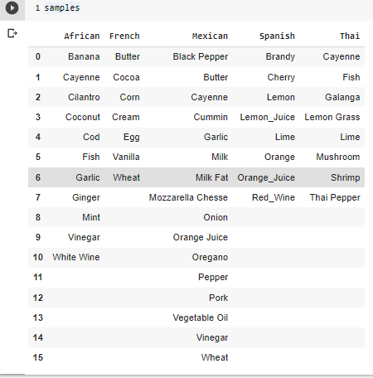
DEMO DATA

Slide 12
THANK YOU!

Slide 13
PLOTLY TEAM CONTRIBUTING MEMBERS
John Kennedy Kalu
Lois Wakili (Presenter 1)
Chukwuka Kennedy Uche
Adedamola Adesoye (Presenter 2)
Rakiya Emmanuel
Taiwo Kuponu
Humphery Otuniyo
Ikechukwu Okoye

